Slide 1
Chapters 1-2: A Review

Slide 2
Chapter 1:
New World Beginnings,
33,000 B.C.E. – 1769 C.E.

Slide 3
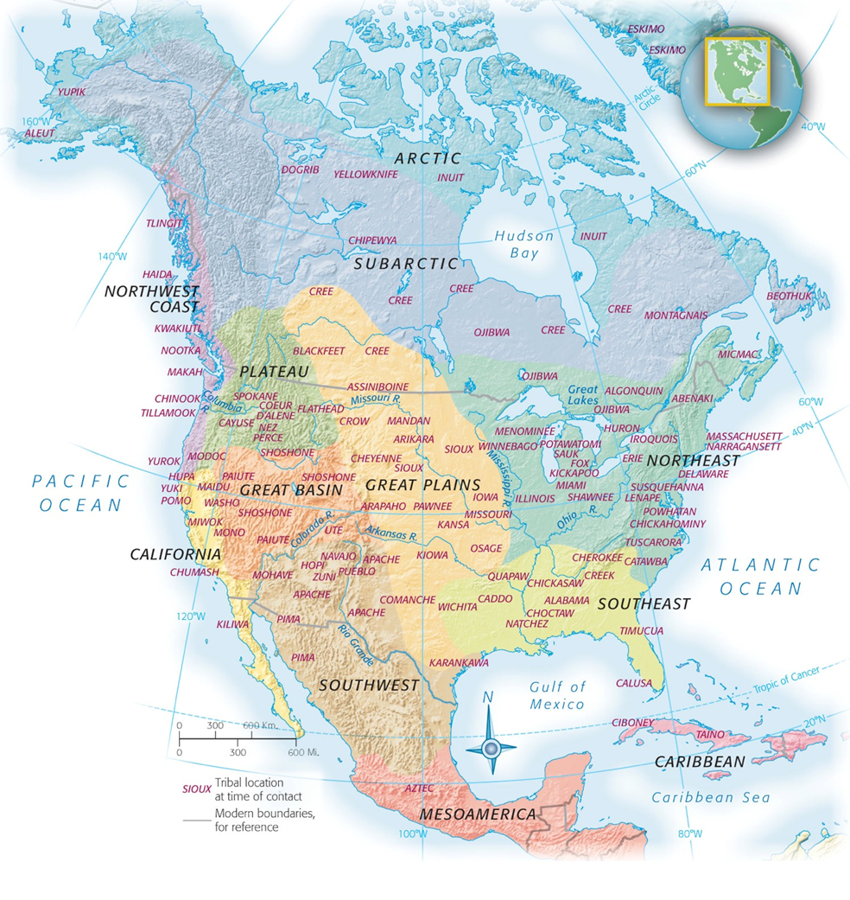
Reasons for Exploration of New World
European demand for more and cheaper products
primarily foodstuffs
Search for New Routes to the East
Ottomans had a monopoly on trade routes
The 3 G’s- “Gold, Glory, Gospel” (Explorers wanted Gold and Glory/ missionaries wanted to convert Natives)

Slide 4
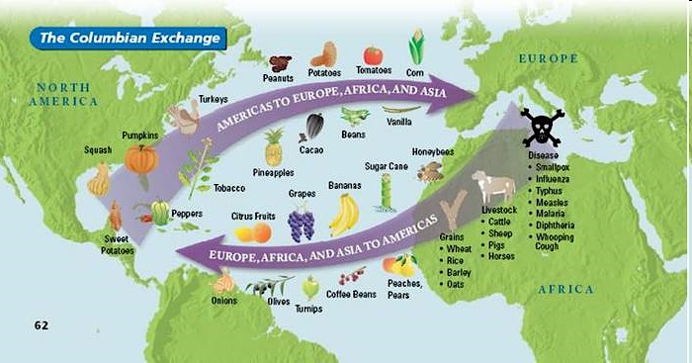
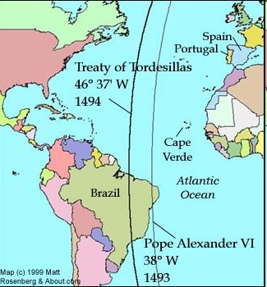
Effects of Exploration
Slave Trade needed for sugar plantations in the West Indies
Spread of disease- Again, “Guns, Germs, and Steel” killed 90% of population
Conflicting Claims- many European nations claimed the same area based on similar explorations
Papal Line of Demarcation (1493)- Pope Alexander VI divided the “new world” between Spain and Portugal
Treaty of Tordesilla (1494), which gave most of the “new world” in the Americas except Brazil to Spain.
The Colombian Exchange:
Dramatically widespread exchange of animal, plants, culture (including slaves), diseases, and ideas between the Eastern and Western hemispheres.
Effects: Cultural Diffusion, changes two worlds forever

Slide 5
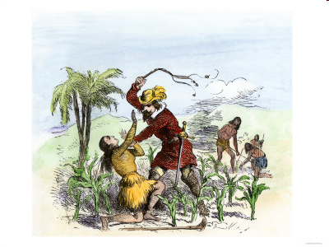
Spain Builds an Empire
Encomienda System - allowed the government to “commend”, or give, Indians and land to certain colonists in return for the promise to try to Christianize them
It really was slavery.
“Black Legend”- false concept held that the conquerors merely tortured and killed the Indians, stole their gold, infected them with smallpox, and left little but misery behind.
Somewhat true
They grafted their culture, laws, religion, and language into the native societies. This laid the foundation for the modern-day Spanish speaking nations.
The Spanish also incorporated indigenous culture with their own, rather than isolating and shunning the Indians as the English did!
Intermarriage

Slide 6
Chapter 2:
Planting of English America,
1500-1733

Slide 7
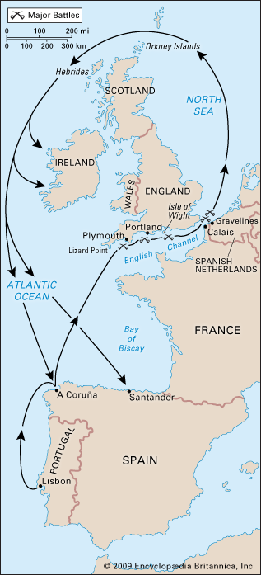
England Emerges
Spanish Armada is defeated by England; England emerges as a naval power
Also brings a Protestant nation to the forefront (Spain was Catholic)

Slide 8
Characteristics of English Empire
Types of Colonies:
Charter-
chartered trading companies made up of stock-holders who shared both the profits and the losses of the colonies (a.k.a. “joint stock company”)
Ex: Virginia
Proprietorships-
Royal grant of land to Royal favorites
Ex: Maryland (Lord Baltimore)
Royal-
ruled by the Crown of England
Ex: Georgia

Slide 9
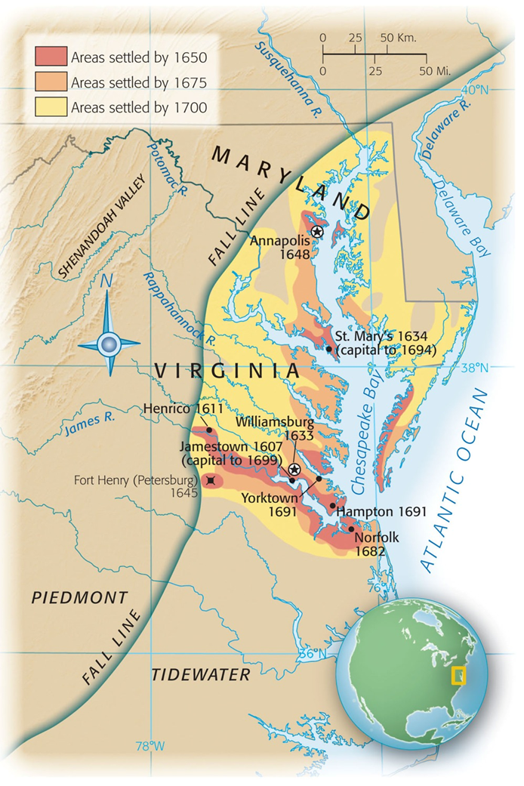
Chesapeake Bay
Made up of Virginia and Maryland
Indentured servants were early labor source until Bacon’s Rebellion
John Rolfe (Jamestown) introduces tobacco and saves colony
Representative self-government
1619: House of Burgesses
Earliest form of self-government
Powhattan Confederacy: Neighboring Native American Tribe, fell victim to 3 D’s.
Disease, Disorganization, Disposability

Slide 10
MD and VA key terms
VA = What type of colony?
Charter or…
“joint-stock company”
“primogeniture”
Laws that decreed only the eldest sons were eligible to inherit landed estates (in England)
Others were forced to seek their fortunes elsewhere (in the New World)
MD = What type of colony?
Proprietorship (Lord Baltimore)
Acts of Toleration – guarantees religious toleration to all Christians ONLY
Not to Jews!
Indentured Servants: Europeans that agreed to work for a period of 5-7 years in exchange for passage to America

Slide 11
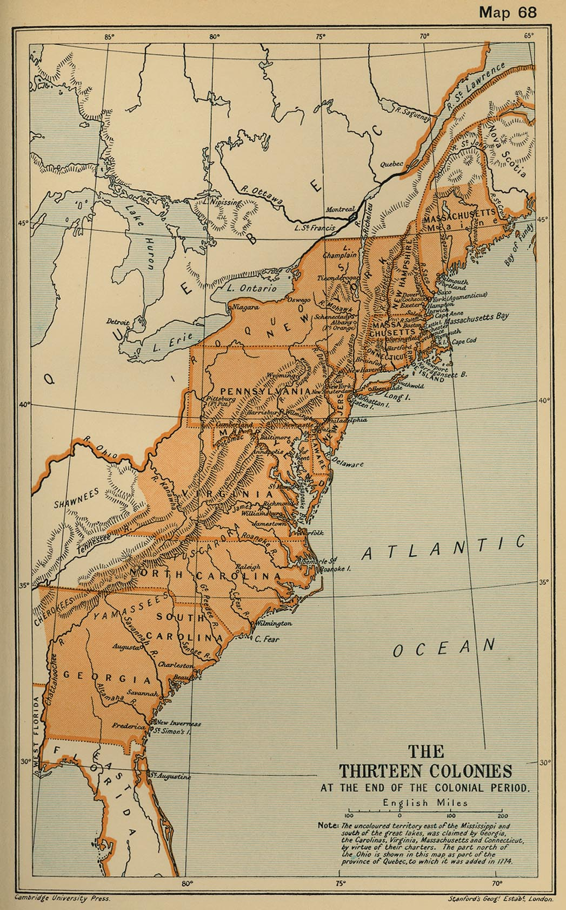
Georgia: The Buffer Colony
Georgia
Last of the original 13 colonies formed in 1733 originally as a buffer between aristocratic South Carolina and Spanish Florida and French Louisiana.
Also a penal colony for debtors
James Oglethorpe became the leading statesman in Georgia, repelled Spanish attacks
Later, in 1750, Georgia adopts the plantation system modeled after SC

Slide 12

That’s it!
Get off to a good start & review your notes!
Visit the class wiki or APUSHReview.com
Help spread the word.
Questions? Comments? Ideas for videos?
Email me (Mr. Cirbo)
Visit APUSHReview.com for more nuggets of wisdom!

